Slide 1
Kohlberg moral development theory
Dr. sunita kejriwal

Slide 2
introduction
Moral development is the process by which people develop the distinction between right and wrong (morality) and engage in reasoning between the two (moral reasoning).Cognitive in nature, Kohlberg's theory focuses on the thinking process that occurs when one decides whether a behaviour is right or wrong. Thus, the theoretical emphasis is on how one decides to respond to a moral dilemma, not what one decides or what one actually does.

Slide 3
definition
Kohlberg extended Piaget's theory, proposing that moral development is a continual process that occurs throughout the lifespan. Kohlberg's theory outlines six stages of moral development within three different levels. Kohlberg was not interested so much in the answer to whether Heinz was wrong or right but in the reasoning for each participant's decision. He then classified their reasoning into the stages of his theory of moral development.

Slide 4
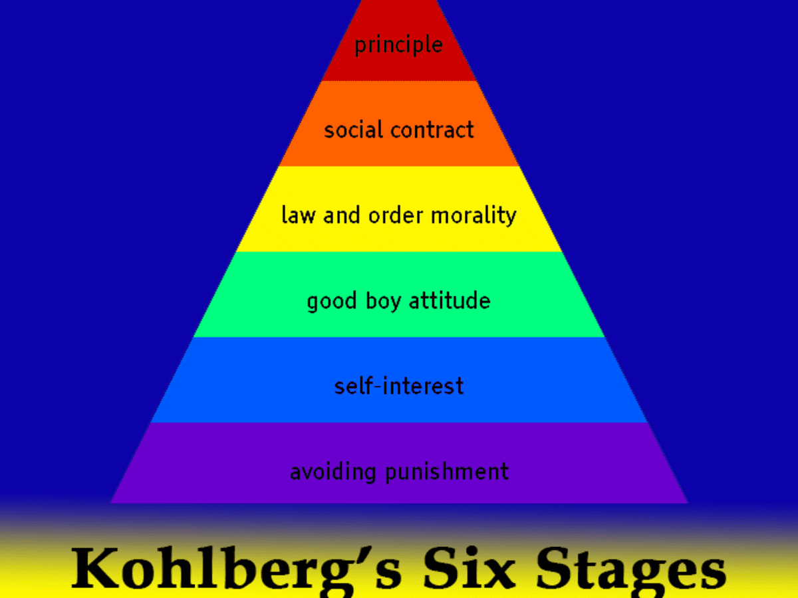
Stages of kohlberg

Slide 5
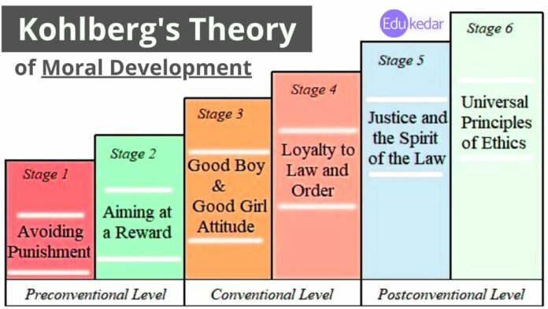
Kohlbergs levels and stages

Slide 6
1. Pre Conventional Level Morality
Stage 1: Obedience Orientation and Avoiding Punishment
Stage 2: Individualism and Exchange (Aiming at reward)
2.Conventional Level Morality
Stage 3: Good Boy Image/ Good Person Attitude
Stage 4: Maintaining the Social & Law Order
3. Post-Conventional Level Morality
Pre Conventional Level Morality
Stage 5. Social Contract and Individual Rights & Justice
Stage 6. Universal Principles & Ethics

Slide 7
Criticism of Kohlberg’s Theory of Moral Development
Some other key criticisms of Kohlberg’s theory are as follows;
Too much focuses on moral thinking and not enough on moral behavior.
Kohlberg suggested morality in women is less fully developed than in men.
Completely Underestimated the contribution of relationships and family.
Kohlberg’s theory is culturally biased and not universal.
Stage theories in general are not adequate to define moral development.

Slide 8
Gilligan claims that there is a sex bias in Kohlberg’s theory. He neglects the feminine voice of compassion, love, and non-violence, which is associated with the socialization of girls.
Gilligan concluded that Kohlberg’s theory did not account for the fact that women approach moral problems from an ‘ethics of care’, rather than an ‘ethics of justice’ perspective, which challenges some of the fundamental assumptions of Kohlberg’s theory.

Slide 9
Conclusion
Lawrence Kohlberg’s theory gives structure to an otherwise difficult to understand phenomenon. His development of morality influenced the theory of moral development in women proposed by Carol Gilligan and continues to circulate in academic circles worldwide. His work finds value not only in the world of psychology but in the world of education as well. Comprehension of his stages of moral development is important when attempting to understand the behavior and decisions made by students. Accurate assignment to a stage of development can help teachers understand why students do the things they do and how to best approach them. For example, it is useless to attempt to convince a student that she should sit quietly in her seat when the teacher is gone if she is in stage one of her moral development. The teacher must instead find a way to maintain the illusion of an authoritative figure while absent from the classroom. Ultimately, the theory provides the teacher with the tools necessary to manage the classroom, thus enhancing the potential success of the lessons

Slide 10
Thank you

