Slide 1
MS PAINT
NAME:-KHUSHBOO AGARWAL
CLASS:- B.COM(HONS) 2ND YEAR3RD SEM
CU ROLL NO :-
CU REGISTRATION NO :-

Slide 2
INDEX
INTRODUCTION
FEATURE
ADVANTAGES
DISADVANTAGES
USES OF MS PAINT
IMPORTANCE OF MS PAINT
PURPOSE OF MS PAINT AND ITS FUNCTION
TOOLS OF MS PAINT
ACKNOWLEDGEMENT
BIBILIOGRAPHY

Slide 3
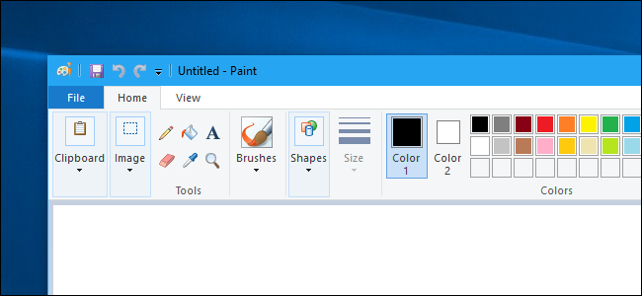
INTRODUCTION
Microsoft Paint or 'MS Paint' is a basic graphics/painting utility that is included in all the Microsoft Windows versions. MS Paint can be used to draw, colour and edit pictures, including imported pictures from a digital camera for example.
BACK

Slide 4
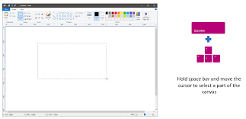
FEATURES
Features included in paint are pencil, brush and airbrush tool. The ability to add text, lines and shapes. Also included are an eraser, magnifier, and fill colour tools.
BACK

Slide 5
ADVANTAGES OF MS PAINT
The advantages of MS Paint are simplicity, user-friendliness and cost-effectiveness. It is mainly you can use for some general editing in the images. But if you want more functions you need to install software like coral draw, photoshop. It has no advantages because it it too free hand and is hard to use.
BACK

Slide 6
DISADVANTAGES OF MS PAINT
Microsoft Paint is a useful utility, but it is not a professional image editing solution such as Photoshop because it has a few very significant limitations.
No Support for Multiple Layers.
No Filters and Retouching Options.
No Smudge Tool.
No Support for Other Operating Systems
BACK

Slide 7
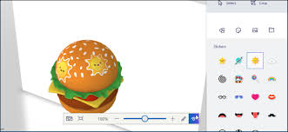
USES OF MS PAINT
Microsoft Paint or 'MS Paint' is a basic graphics/painting utility that is included in all the Microsoft Windows versions.
MS Paint can be used to draw, colour and edit pictures, including imported pictures from a digital camera for example.
MS Paint is found in the Windows Start menu within the Accessories Folder.
BACK

Slide 8
IMPORTANCE OF MS PAINT
Microsoft Paint gives the users the ability to draw simple images from scratch , Paint functions as a simple image manipulation tool that allows the users to work with the images from a scanner or digital camera without needing to download additional software
BACK

Slide 9
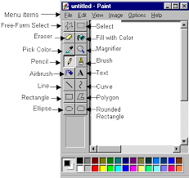
PURPOSE OF MS PAINT AND ITS FUNCTION
Microsoft Paint or 'MS Paint' is a basic graphics/painting utility that is included in all the Microsoft Windows versions. MS Paint can be used to draw, colour and edit pictures, including imported pictures from a digital camera for example. MS Paint is found in the Windows Start menu within the Accessories Folder.
BACK

Slide 10
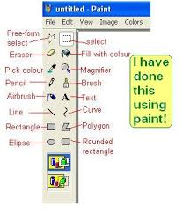
TOOLS OF MS PAINT
Image result for tools of ms paint
The other tools use a brush to modify an image in some way rather than paint on it:
the Bucket Fill fills with color or pattern;
the Gradient fills with gradients;
the Eraser erases;
the Clone tool copies from a pattern, or image;
the Perspective Clone tool copies into a changed perspective;
BACK

Slide 11
ACKNOWLEDGEMENT
I would like to express my special thanks of gratitude to my Computer teacher ''Prof. AMIT CHOUDHARY'' for their able guidance and support in completing my Project. I would also like to extend my gratitude to the Principal Mam ''Dr. SIMA CHAKRABARTI'' for providing me with all the facility that was required.
DATE:
BACK

Slide 12
BIBILIOGRAPHY
The Content for this project report has been taken from the following sources:-
www.schoolchalao.com
https://docs.gimp.org
https://www.digitalunite.com
https://technology.blurtit.com
https://www.online-sciences.com
ask.brothersoft.com

Slide 13
THANK-YOU

