Slide 1

MACROECONOMICS
What causes unemployment?
What causes inflation?
What creates or stimulates economic growth?

Slide 2
What is it?
Macroeconomics is a branch of economics that studies the behavior of an overall economy, which encompasses markets, businesses, consumers, and governments. Macroeconomics examines economy-wide phenomena such as inflation, price levels, rate of economic growth, national income, gross domestic product (GDP), and changes in unemployment.
In its modern form, macroeconomics is often defined as starting with John Maynard Keynes and his book The General Theory of Employment, Interest, and Money in 1936. In it, Keynes explained the fallout from the Great Depression, when goods went unsold and workers were unemployed.

Slide 3
What is it?
Macroeconomic models, and the forecasts they produce, are used by government entities to aid in constructing and evaluating economic, monetary, and fiscal policy. Businesses use the models to set strategies in domestic and global markets, and investors use them to predict and plan for movements in various asset classes.

Slide 4
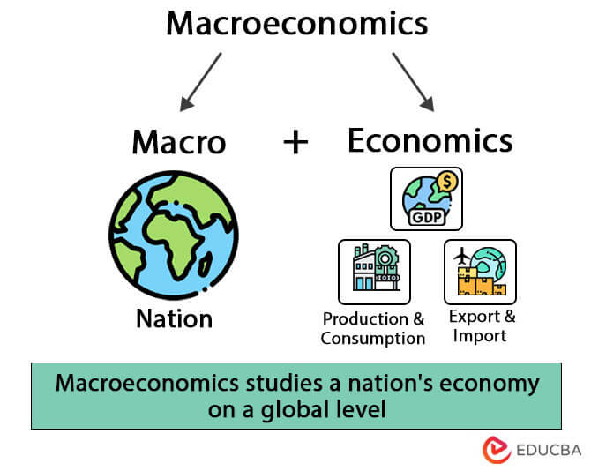

Slide 5
Origin
In its modern form, macroeconomics is often defined as starting with John Maynard Keynes and his book The General Theory of Employment, Interest, and Money in 1936. In it, Keynes explained the fallout from the Great Depression, when goods went unsold and workers were unemployed.
Before that the idea of General Equilibrium (Leon Walras) existed.
Money was considered as a medium of exchange (Knut Wicksell, Irving Fisher, and Ludwig von Mises).

Slide 6
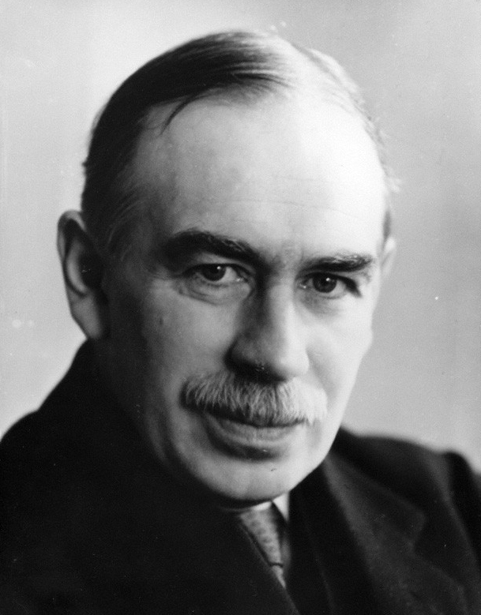
John Maynard Keynes

Slide 7
A detour to Great Depression
The Great Depression of 1929 devastated the U.S. economy. A third of all banks failed. Unemployment rose to 25%, and homelessness increased. Housing prices plummeted, international trade collapsed, and deflation soared. It took 25 years for the stock market to recover.
During the first five years of the depression, the economy shrank by 50%. In 1929, economic output was $105 billion, as measured by gross domestic product (GDP).

Slide 8
A detour to Great Depression
Black Monday, October 28, 1929.
Post WW I (The Roaring 20s).
The nature of the economy in the United States and elsewhere shifted, as ordinary consumers buying durable goods such as appliances and cars—often on credit—became more and more important. it also made them vulnerable to sudden shifts in consumer confidence.

Slide 9
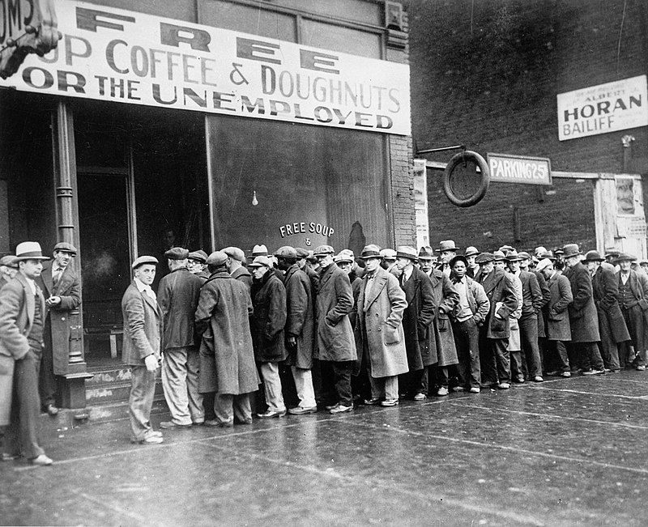

Slide 10
A detour to Great Depression
Financial Speculation
Opportunity to become rich by investing.
Americans were fleeced by con artists who sold them on shady schemes, from Florida swampland and nonexistent oil deposits to the notion of buying Spanish mail coupons and redeeming them for U.S. stamps to profit on the weaker Spanish currency.
Investors increasingly bought stocks on margin.(i.e investing by borrowing money).

Slide 11
A detour to Great Depression
Blunders by the Federal Reserve.
There was a drastic 67 percent increase in the money supply between 1921 and 1929.
That policy led to declining interest rates, which encouraged people to borrow and overinvest.
But eventually, in 1929, the Fed’s board worried that speculation was out of control, and abruptly slammed on the breaks by contracting the money supply and raising interest rates.
The Fed got the stock market to come down. But then it came down a lot, and it came down very quickly.

Slide 12
A detour to Great Depression
Trade protectionists in Congress enacted the Smoot-Hawley Act, which was written in early 1929, while the economy still seemed to be going strong. But after the Wall Street Crash weakened the economy, President Hoover still signed it into law in 1930. The law raised U.S. tariffs by an average of 16 percent, in an effort to shield American factories from the competition with foreign countries’ lower-priced goods. But the move backfired when other countries put tariffs on U.S. exports.

Slide 13
A detour to Great Depression
Gold Standard
The Fed then moved to jack up interest rates higher to protect the dollar’s value. But those high-interest rates made it difficult for businesses to borrow the money that they needed to survive, and many ended up closing their doors instead.
US economy didn’t really get back to normal until after the war when the victorious United States emerged as the world’s leading economy.

Slide 14
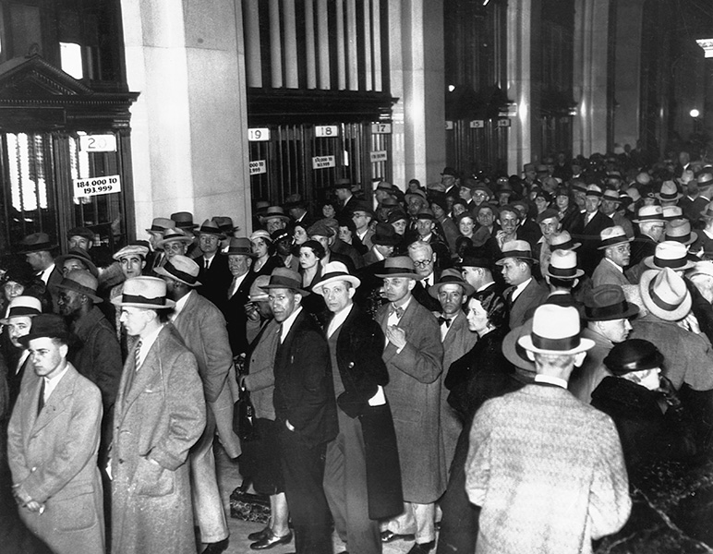

Slide 15
Microeconomics Vs Macroeconomics
A key distinction between microeconomics and macroeconomics is that macroeconomic aggregates can sometimes behave in very different ways or even the opposite of similar microeconomic variables.
Example- Paradox of Thrift

Slide 16
Macroeconomic Schools of Thought
Classical economics held that prices, wages, and rates are flexible and markets tend to clear unless prevented from doing so by government policy; these ideas build on Adam Smith's original theories.
Keynesian economics believe that the business cycle can be managed by active government intervention through fiscal policy and monetory policy. Keynes and was the beginning of macroeconomics as a separate area of study from microeconomics. Keynesians focus on aggregate demand as the principal factor in issues like unemployment and the business cycle.

Slide 17
Macroeconomic Schools of Thought
The Monetarist school is a branch of Keynesian economics credited mainly to the works of Milton Friedman. Working within and extending Keynesian models, Monetarists argue that monetary policy is generally a more effective and desirable policy tool to manage aggregate demand than fiscal policy.
Stagflation (1970)

Slide 18
Macroeconomic Schools of Thought
New Classical economists assume that all agents try to maximize their utility and have rational expectations, which they incorporate into macroeconomic models. New Classical economists believe that unemployment is largely voluntary and that discretionary fiscal policy destabilizes, while inflation can be controlled with monetary policy.
New Keynesians accept that households and firms operate based on rational expectations, they still maintain that there are a variety of market failures, including sticky prices and wages. Because of this "stickiness," the government can improve macroeconomic conditions through fiscal and monetary policy.

Slide 19
Macroeconomic Schools of Thought
Austrian theories also have important implications for what are otherwise considered macroeconomic subjects. In particular, the Austrian business cycle theory explains broadly synchronized (macroeconomic) swings in economic activity across markets due to monetary policy and the role that money and banking play in linking (microeconomic) markets to each other and across time.

Slide 20
